Slide 1
PYTHON COLLABORATIVE PROJECT
Student Energy
Planner
A rule-based Python command-line tool for organizing study tasks and suggesting a time-bounded study plan.
1
2
3
TASKS
PRIORITY
PLAN
PROJECT TEAM
Omansh Aneja • S26CSEU2199
Vansh Gandhi • S26CSEU2207
Yash Aggarwal • S26CSEU2206
Aditya Rao • S26CSEU2265
Ayush Kumar • S26CSEU2239

Slide 2
Our Team
Team roles and actual contributions should be confirmed by the group before final submission.
TEAM MEMBER
STUDENT ID
CONTRIBUTION
Omansh Aneja
S26CSEU2199
Core Developer – Designed the project logic, developed the priority algorithm, implemented the scheduling system, integrated modules, and handled final testing.
Vansh Gandhi
S26CSEU2207
Input & Data Management – Responsible for task input structure, data organization, and JSON-based storage module.
Yash Aggarwal
S26CSEU2206
Output & Testing – Responsible for output presentation, test-case planning, and functionality review.
Aditya Rao
S26CSEU2265
Documentation & Research – Responsible for project documentation, technical research, and concept explanation.
Ayush Kumar
S26CSEU2239
Presentation & Review – Responsible for presentation structure, visual communication, and project review
STUDENT ENERGY PLANNER • PROJECT REPORT
02

Slide 3
Introduction
Local command-line application • JSON persistence • Rule-based scheduling
ENTER TASK
SAVE JSON
RANK TASKS
BUILD PLAN
REVIEW OUTPUT
WHAT THE PLANNER DOES
“Energy” means student-entered focus ratings. The program does not measure physiology, sleep, attention, or biological energy. Its plan is a rule-based suggestion based on user estimates.
Student Energy Planner is a Python command-line application that helps a student keep study tasks together and create a suggested plan for a chosen study window. A student records task and deadline information, estimated effort, difficulty, and focus need. The planner uses these details with current focus and available time to order tasks and propose study blocks.
STUDENT ENERGY PLANNER • PROJECT REPORT
03

Slide 4
Problem Statement
Assignments, revision, and other study work arrive together.
Some deadlines are closer than others.
Available study hours must be shared across tasks.
1
Many tasks
2
Different urgency
3
Limited time
PROBLEM TO SOLVE
How can a student organize tasks and create a clear, time-bounded work sequence using task urgency, estimated effort, focus needs, and available study time?
Students may have several assignments, revision tasks, and other study work competing for a limited number of hours.
STUDENT ENERGY PLANNER • PROJECT REPORT
04

Slide 5
Objectives
OBJECTIVE
INTENDED RESULT
Collect task details
Store task name, days remaining, deadline time, difficulty, estimated hours, and focus need.
Keep task data locally
Load and save task records through JSON.
Support prioritization
Order tasks with urgency first, then focus match, then difficulty.
Plan within constraints
Fit study blocks into both the bedtime window and maximum focused-study allowance.
Explain unfinished work
Show task minutes that remain unscheduled.
STUDENT ENERGY PLANNER • PROJECT REPORT
05

Slide 6
Features and Modules
MODULE
RESPONSIBILITY
Menu loop
Routes choices to add, view, plan, delete, or exit.
Task input and validation
Checks time fields, numeric ranges, positive study hours, and focus ratings.
JSON persistence
load_tasks() reads tasks.json; save_tasks() writes the current task list.
Task display / deletion
Shows numbered records and removes a selected record after confirmation.
Time helpers
Converts HH:MM to minutes and back, including midnight wrap.
Priority helper
Builds a tuple score from urgency, focus match, and difficulty.
Study planner
Creates study and break intervals, updates limits, and records leftovers.
STUDENT ENERGY PLANNER • PROJECT REPORT
06

Slide 7
Algorithm and Flowchart
PLANNING STEPS
SCHEDULING RULES
Load saved tasks and show the menu.
Each study block is the minimum of session length, task time left, bedtime-window time left, and focused-study time left.
Validate current time, focus, bedtime, and maximum study hours.
Focus 1-2: 20 minutes for first two sessions, then 25. Focus 3: 30 minutes. Focus 4-5: 40 minutes.
Convert times to minutes; move bedtime to the next day when it is earlier than or equal to start time.
Default break: 15 minutes. After study session 4 or 8, break length becomes 60 minutes.
Sort tasks by the priority tuple.
A break is added only after a full study block, when more work remains, enough clock time remains, and study allowance remains.
Add bounded study blocks and allowed breaks.
Print scheduled intervals and any remaining work.
Breaks consume clock time, not focused-study allowance.
START
LOAD JSON
MENU
VALIDATE
SORT TASKS
SCHEDULE
DISPLAY
STUDENT ENERGY PLANNER • PROJECT REPORT
07

Slide 8
Python Concepts Used
CONCEPT
PROJECT USE
WHY IT MATTERS
Strings, integers, floats
Task names, days, ratings, decimal work hours
Represent different input types
Lists and dictionaries
A list holds task dictionaries with named fields
Store structured task records
Functions
Separate task, time, priority, and planning actions
Organize reusable logic
Conditions and loops
Validate inputs; repeat menu and schedule steps
Choose paths and iterate
try / except
Handle invalid conversion and JSON/file errors
Recover from expected problems
JSON and files
json.load reads; json.dump writes tasks.json
Keep tasks between runs
Tuples and sorted()
Order (urgency, focus match, difficulty)
Create predictable priority
//, %, f-strings
Convert minutes, wrap hours, print times
Handle time and readable output
STUDENT ENERGY PLANNER • PROJECT REPORT
08

Slide 9
Computational Feature
Illustrative example: due-today task, 2 estimated hours, difficulty 5, focus need 4; start 09:00, focus 4, bedtime 14:00, cap 2 hours. Score = (5,5,5); available clock = 300 minutes; focused-study cap = 120 minutes.
PRIORITY SCORE
STUDY SESSION LENGTHS
Score = (urgency, focus match, difficulty)
CURRENT FOCUS
STUDY BLOCK
Focus match = 5 - abs(task focus need - current focus). Tuples compare left to right.
1-2: first two sessions
20 minutes
DAYS LEFT
POINTS
1-2: later sessions
25 minutes
0-1
5
3
30 minutes
2-3
4
4-7
3
4-5
40 minutes
More than 7
2
A block is further bounded by remaining task time and both schedule limits. Example values are illustrative, not a recorded run.
STUDENT ENERGY PLANNER • PROJECT REPORT
9

Slide 10
Testing and Results
ID
TEST SCENARIO
EXPECTED BEHAVIOR
OBSERVED RESULT
T1
First run; tasks.json missing
Begin with an empty task list
Program started successfully with an empty task list.
T2
Add valid task, restart
Saved task is loaded again
Task was saved successfully and loaded again after restarting the program
T3
Invalid time / rating
Reject value and prompt again
Invalid input was rejected and the program prompted the user to enter a valid value again
T4
Delete; decline confirmation
Keep selected task unchanged
Task remained unchanged after declining the deletion confirmation
T5
Start 22:00; bedtime 06:00
Treat bedtime as next day
Bedtime was correctly treated as the next day
T6
Task exceeds available hours
Stop at caps; report remainder
Study scheduling stopped at the available time limits and displayed the remaining task duration
T7
Plan with no tasks
Show message and return safely
Program displayed “Add some task first.” and returned safely
The project owner reports that the source code is fully working. Detailed case-by-case outputs were not supplied, so these rows remain pending until recorded.
STUDENT ENERGY PLANNER • PROJECT REPORT
10

Slide 11
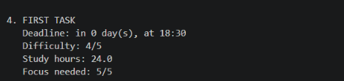
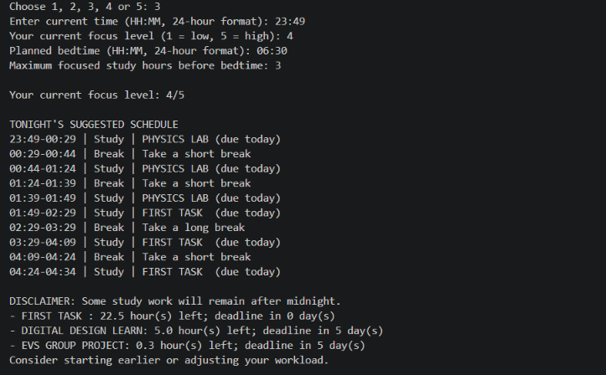
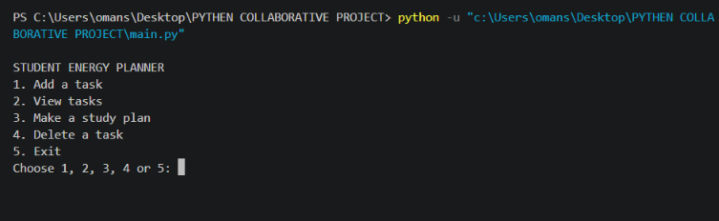
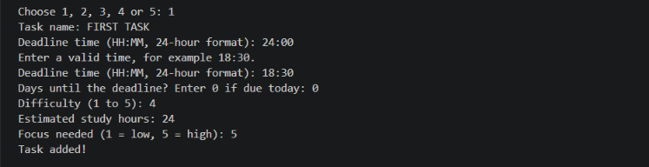
Screenshots
03 Task list
Show the saved records
04 Study plan
Show blocks, breaks, and remainder
[INSERT REAL TERMINAL CAPTURE]
[INSERT REAL TERMINAL CAPTURE]
01 Main menu
Show available menu actions
[INSERT REAL TERMINAL CAPTURE]
02 Add task
Show validation and save confirmation
STUDENT ENERGY PLANNER • PROJECT REPORT
11

Slide 12
Challenges and Learning
CHALLENGE
HOW THE PROGRAM HANDLES IT
LEARNING
Invalid input
Validation loops and specific exceptions
Check values before calculations
Task persistence
List of dictionaries saved as JSON
Separate data structure from file format
Clock arithmetic
Convert HH:MM into total minutes
Use one unit for interval math
Overnight plan
Add 1,440 minutes when bedtime crosses midnight
Represent next-day windows explicitly
Multiple time caps
min() bounds every study block
Update counters after each block
Priority ordering
Sort tuples left to right
Know how tie-breaks affect order
Source maintenance
Some session/break constants are declared but the loop uses local values
Keep configuration and active rules aligned
The code makes the following engineering considerations visible; add personal team examples if available.
STUDENT ENERGY PLANNER • PROJECT REPORT
12

Slide 13
Limitations
CURRENT IMPLEMENTATION
INTERPRETATION
Exact deadline time is stored and displayed but does not control task ordering or placement; days_left sets urgency.
The student should review and adjust the suggested schedule.
Focus and task effort are self-reported; the program does not measure attention, fatigue, or sleep.
Final status messages use fixed “midnight” wording, even when the selected bedtime is different.
This is a local command-line application with deterministic rules. It does not use AI/ML, biological energy sensing, cloud services, or live calendar data.
There is no completion flag, so completed tasks can be planned again unless removed.
Task data is stored locally in tasks.json; no cloud sync, calendar connection, or real-time integration is implemented.
Missing or invalid JSON loads as an empty list; no backup or recovery history is documented.
The planner produces suggestions and cannot guarantee task completion.
STUDENT ENERGY PLANNER • PROJECT REPORT
13

Slide 14
Conclusion
CONCLUSION
Student Energy Planner demonstrates how introductory Python can combine input validation, JSON persistence, task prioritization, time arithmetic, and a bounded scheduling loop. The result is a transparent suggestion that the student can review.
STUDENT ENERGY PLANNER • PROJECT REPORT
14

